Slide 1
Improving the access to a local job market through the use of a location-aware mobile job search application
Aleksander Antoniewicz

Slide 2
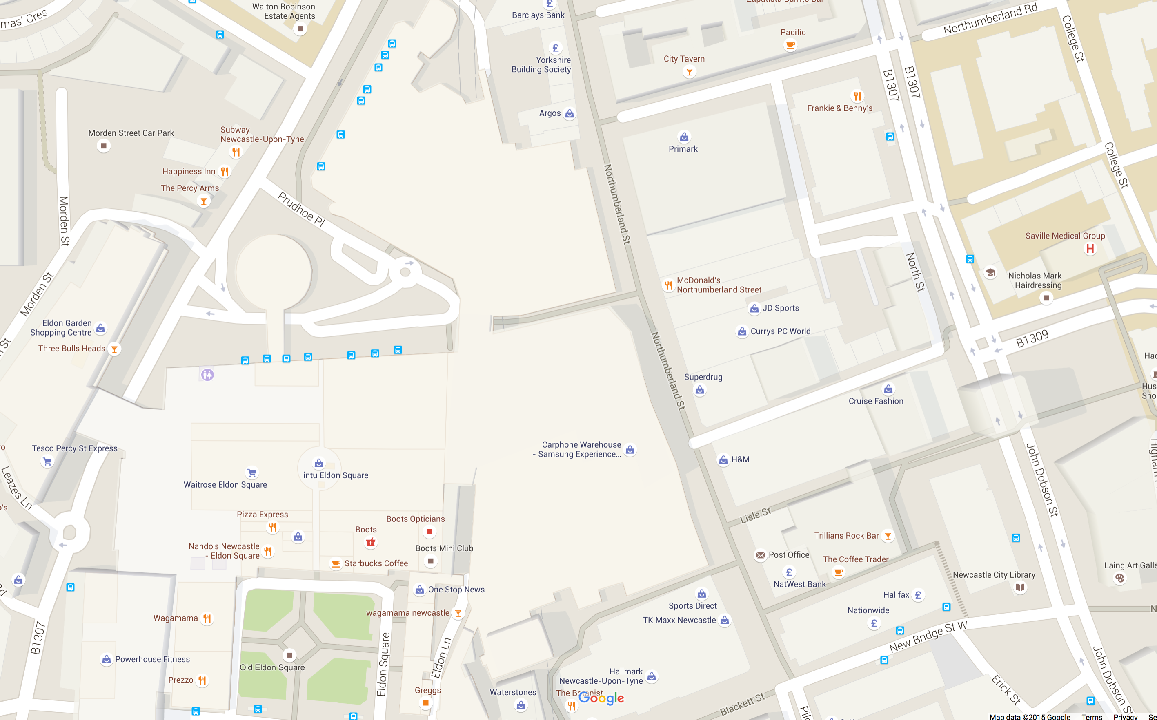
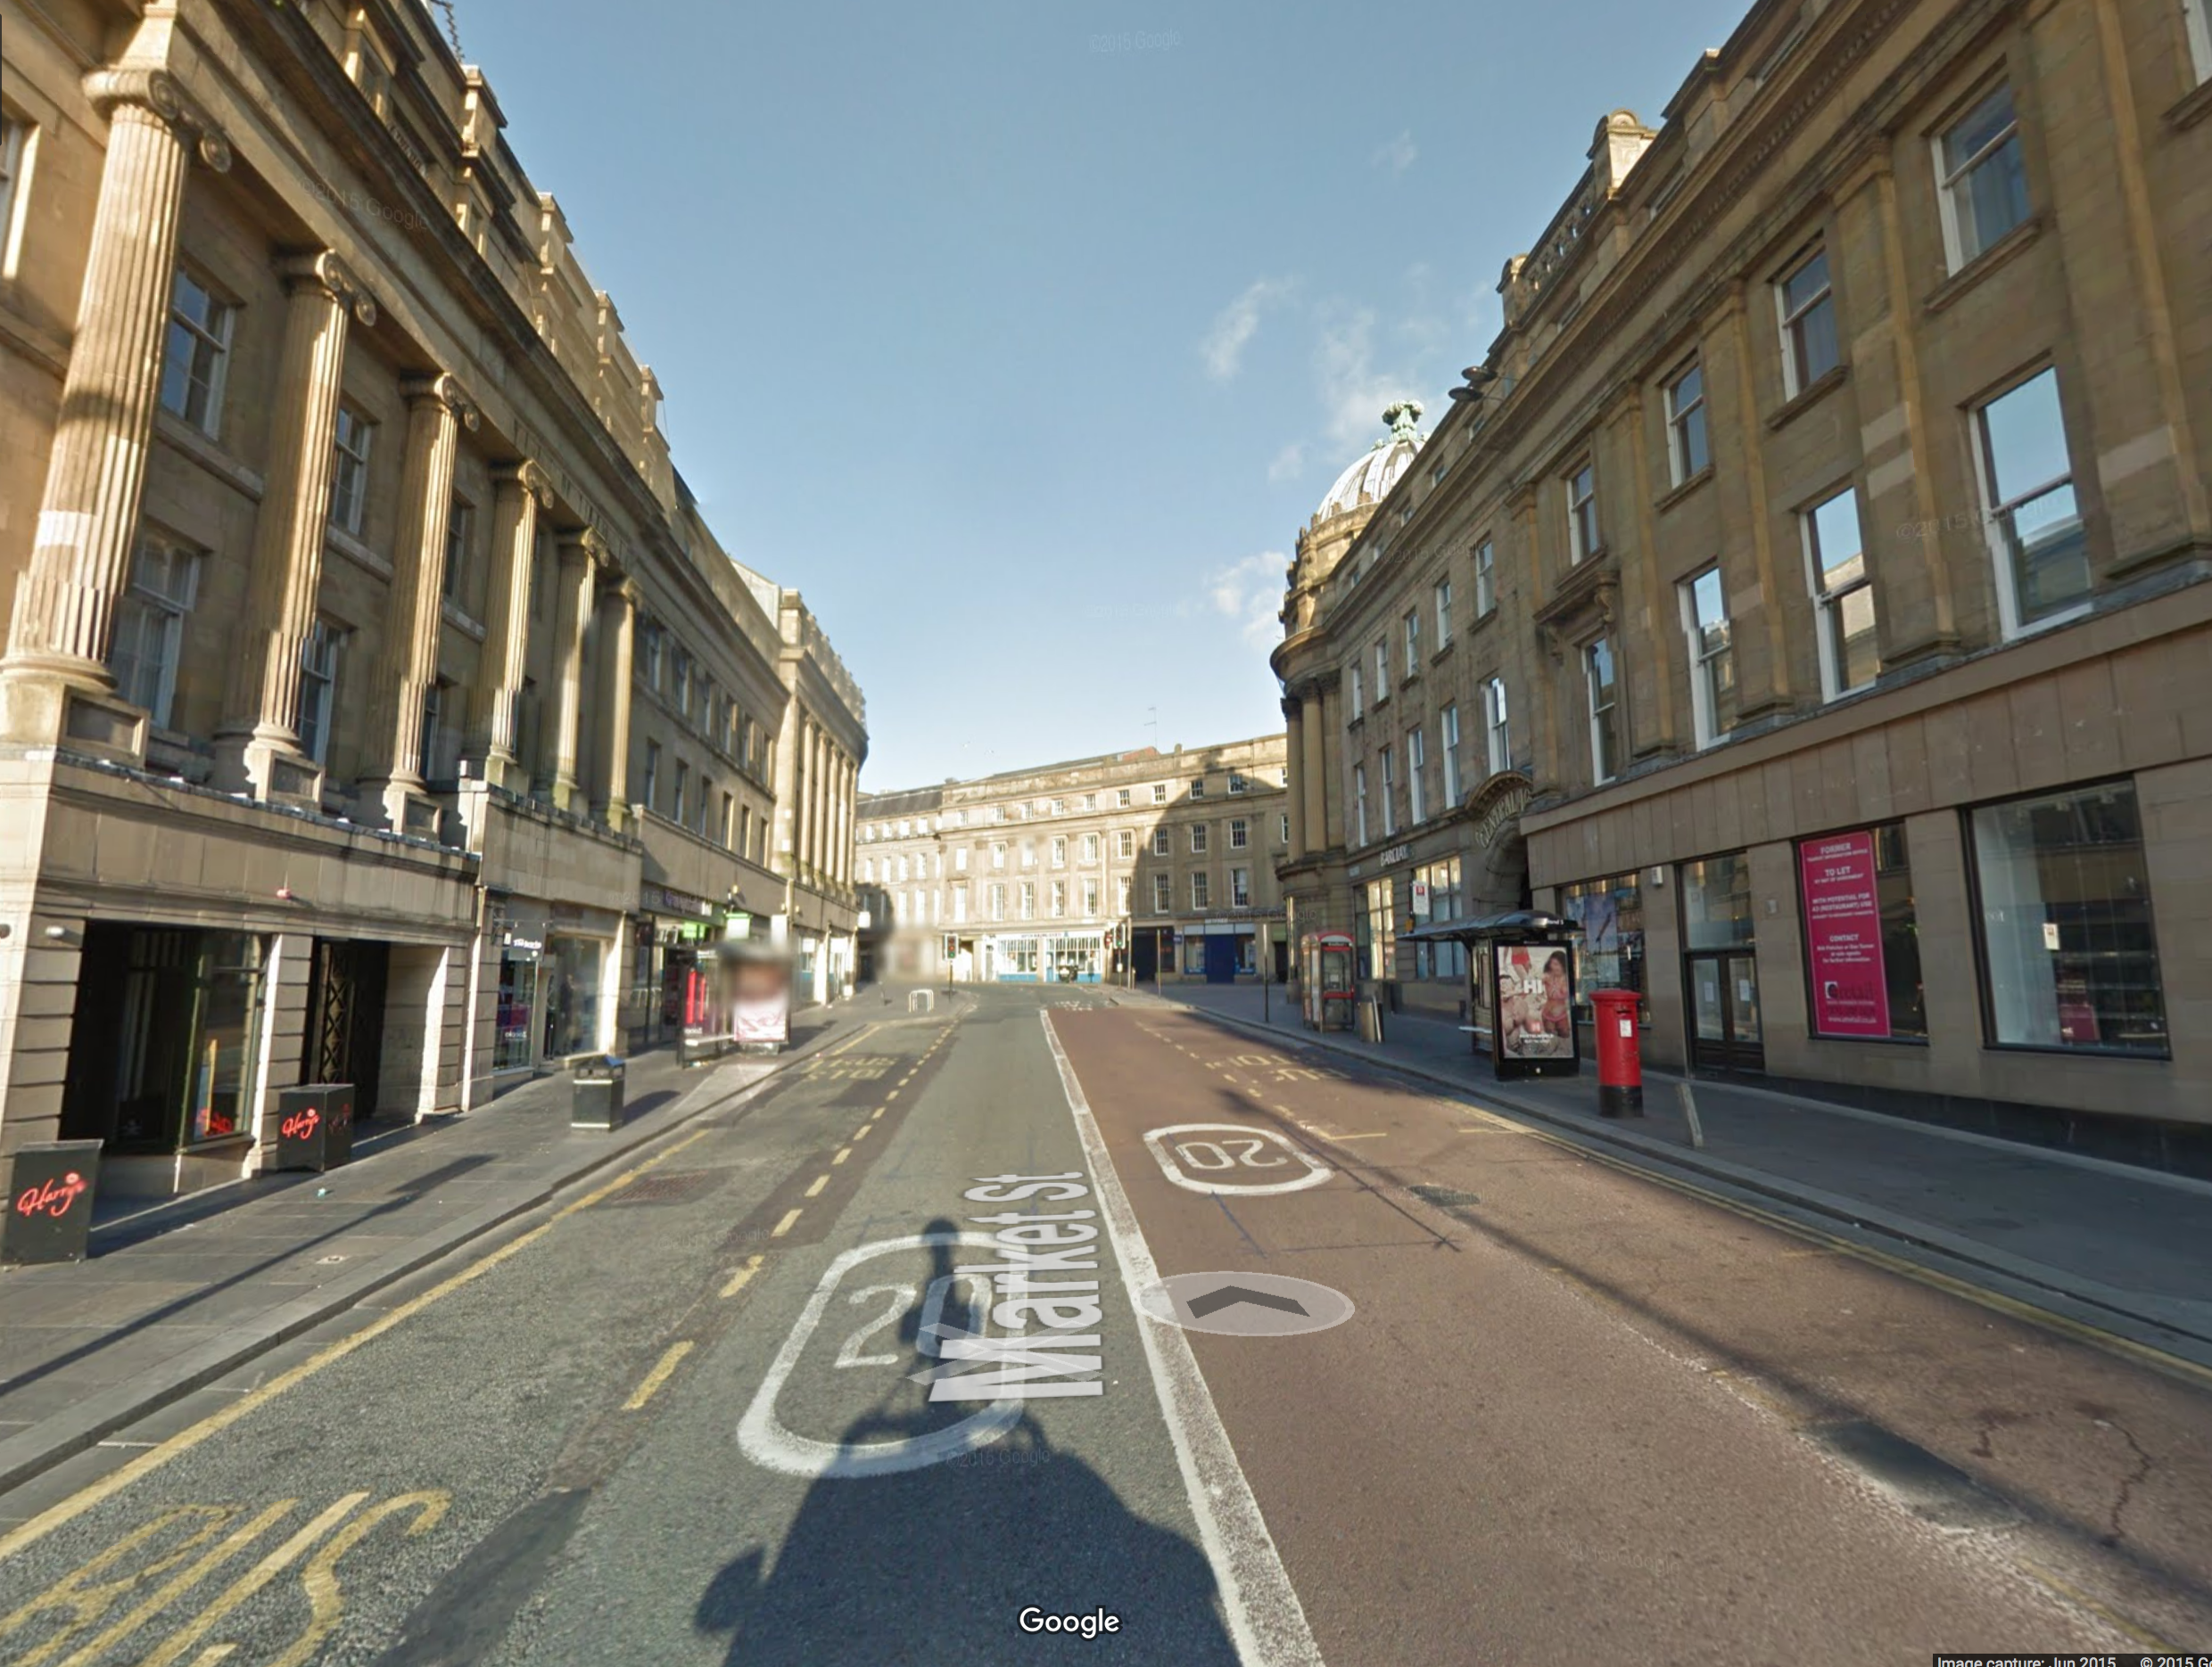
Opportunities around
Images taken from Google Maps and Google StreetView

Slide 3
Aim and objectives
Aim:
“To investigate ways to improve the access to a local job market through the use of a location-aware mobile job search application”
Objectives:
To investigate how the use of sensors in a mobile device can help return personalised job search results
To research the possibility of using Augmented Reality features to enhance user experience
To explore the benefits of using crowdsourcing to increase the database of job vacancies
To test (through user surveys) the effectiveness of the above design

Slide 4






Existing solutions

Slide 5

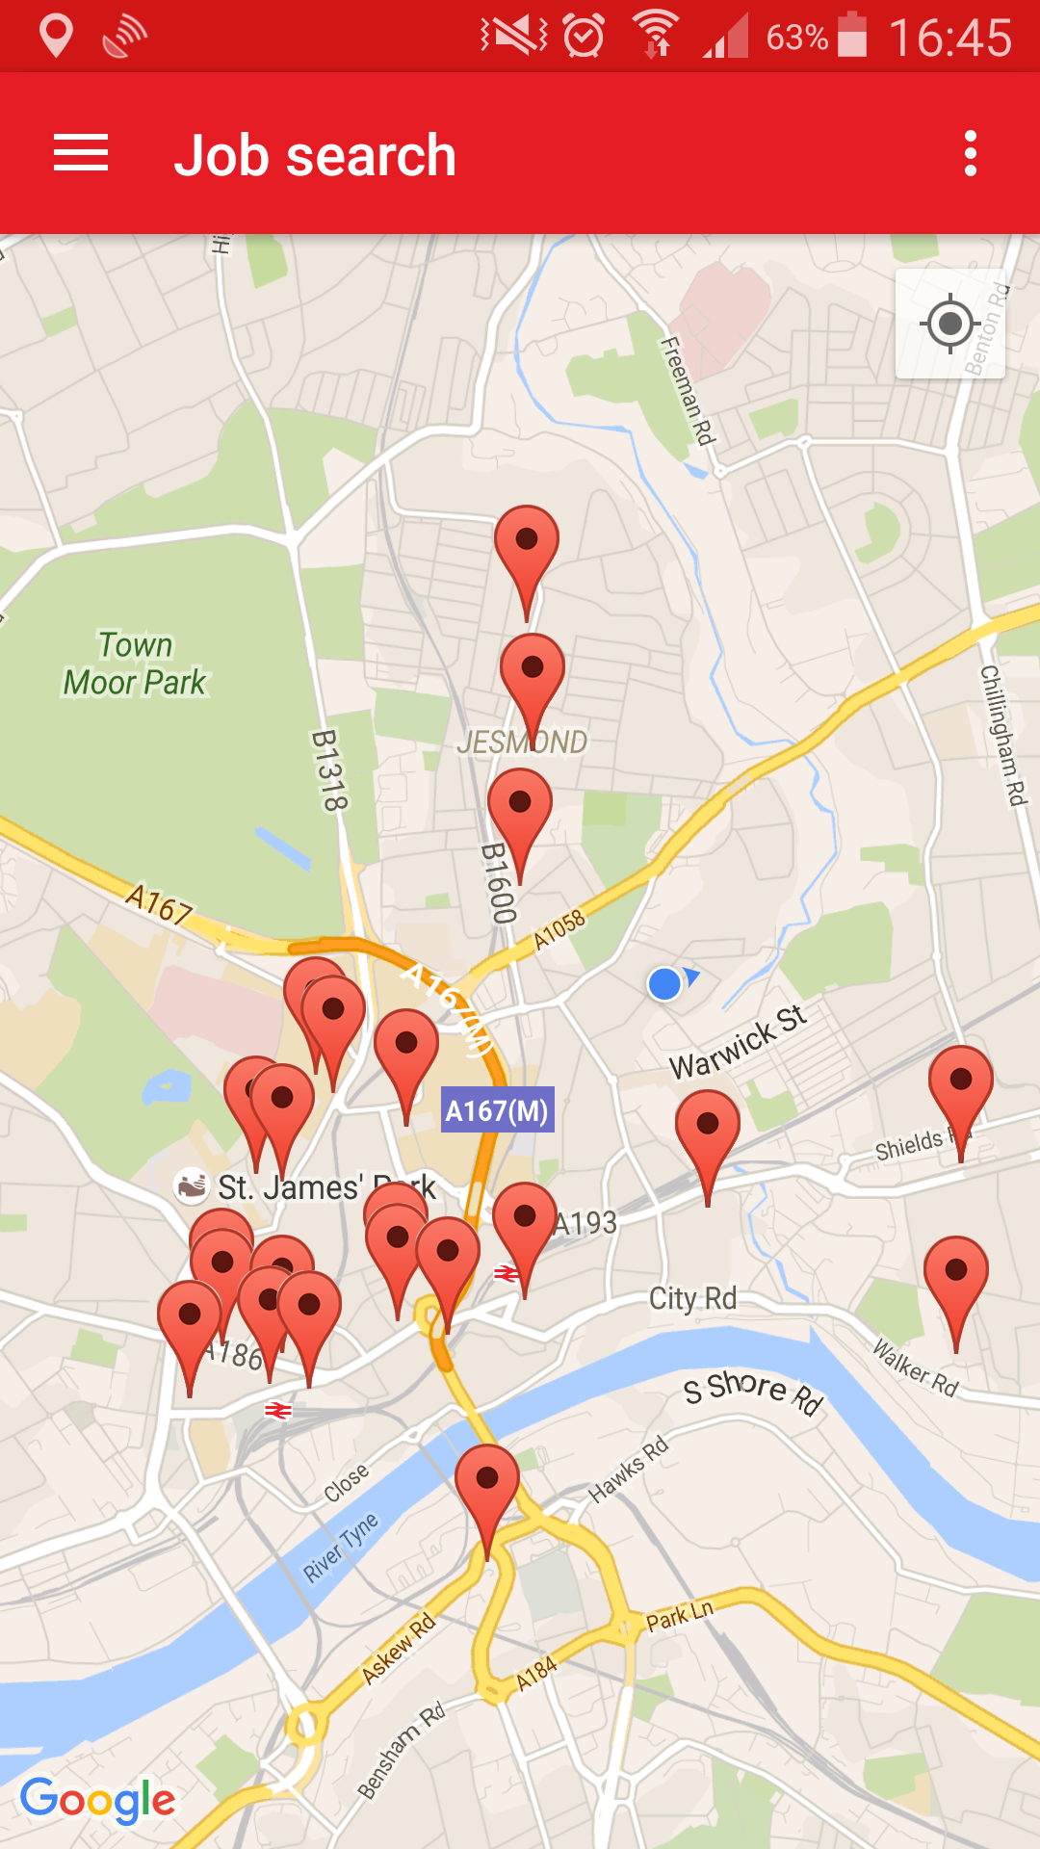
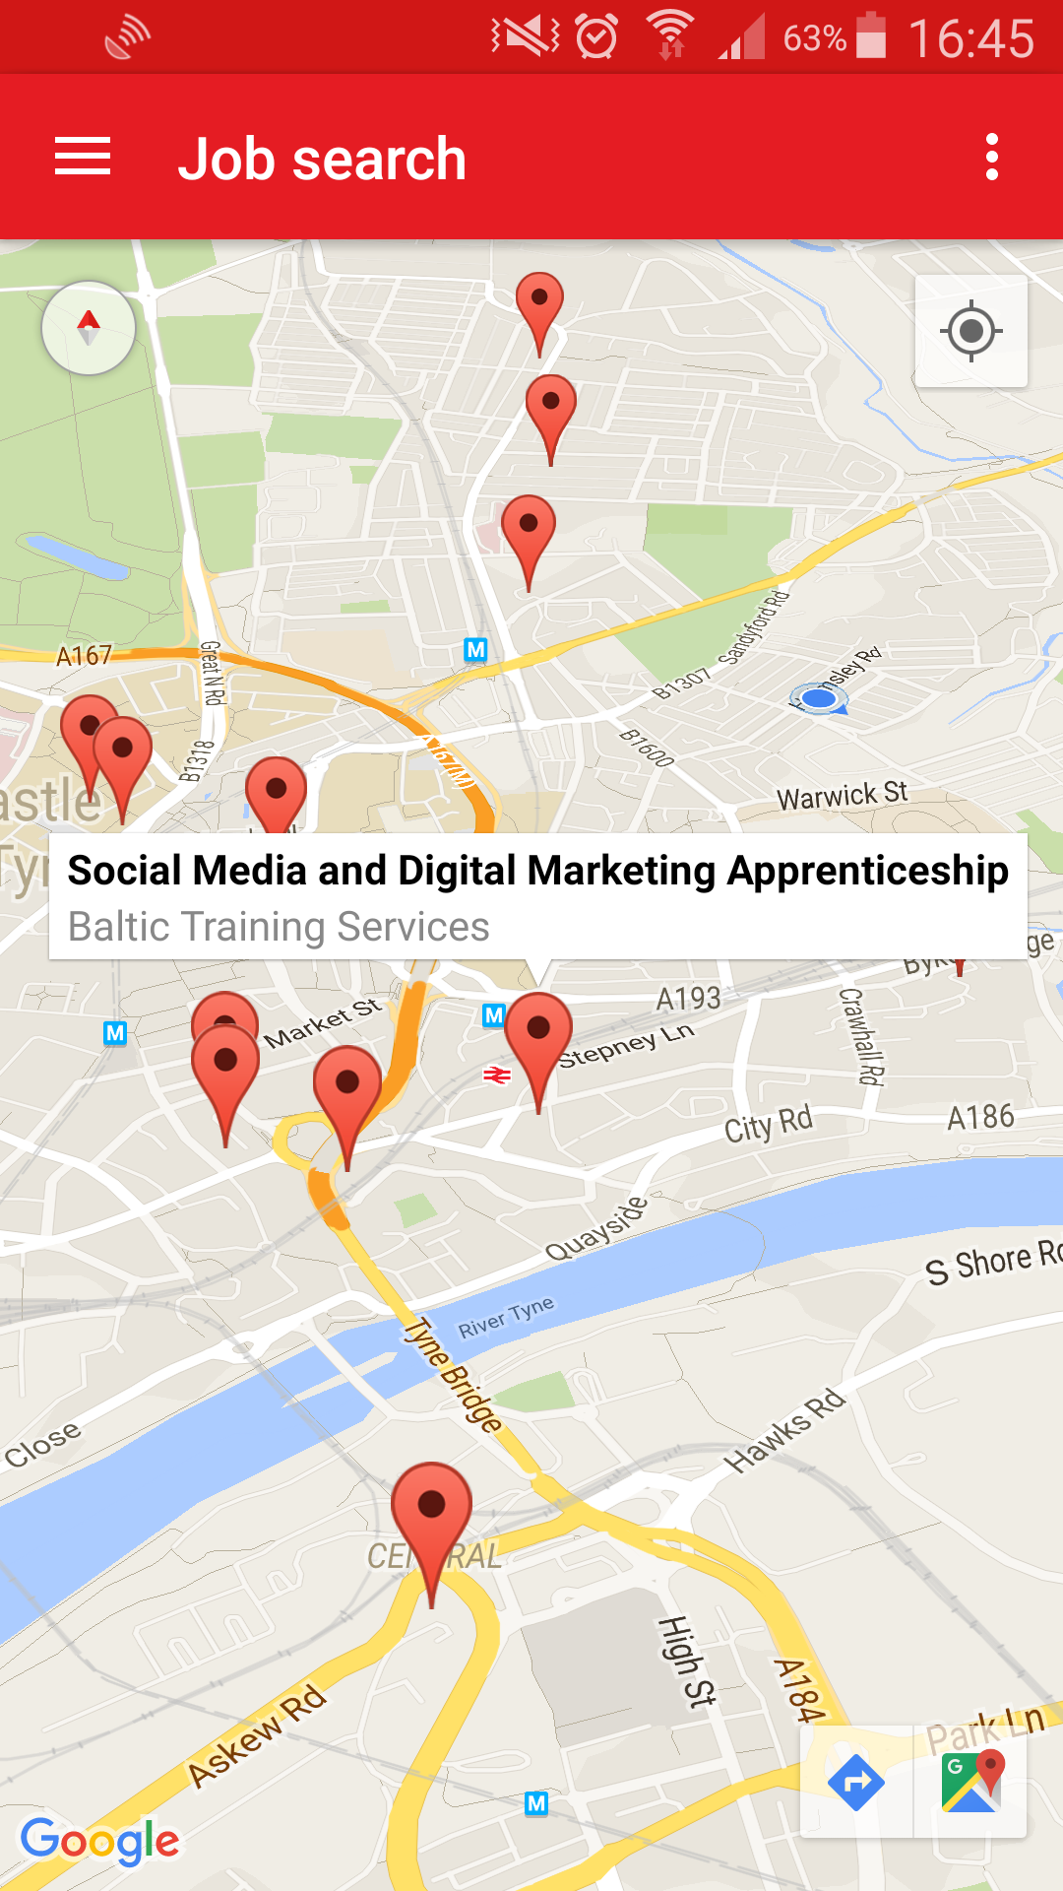
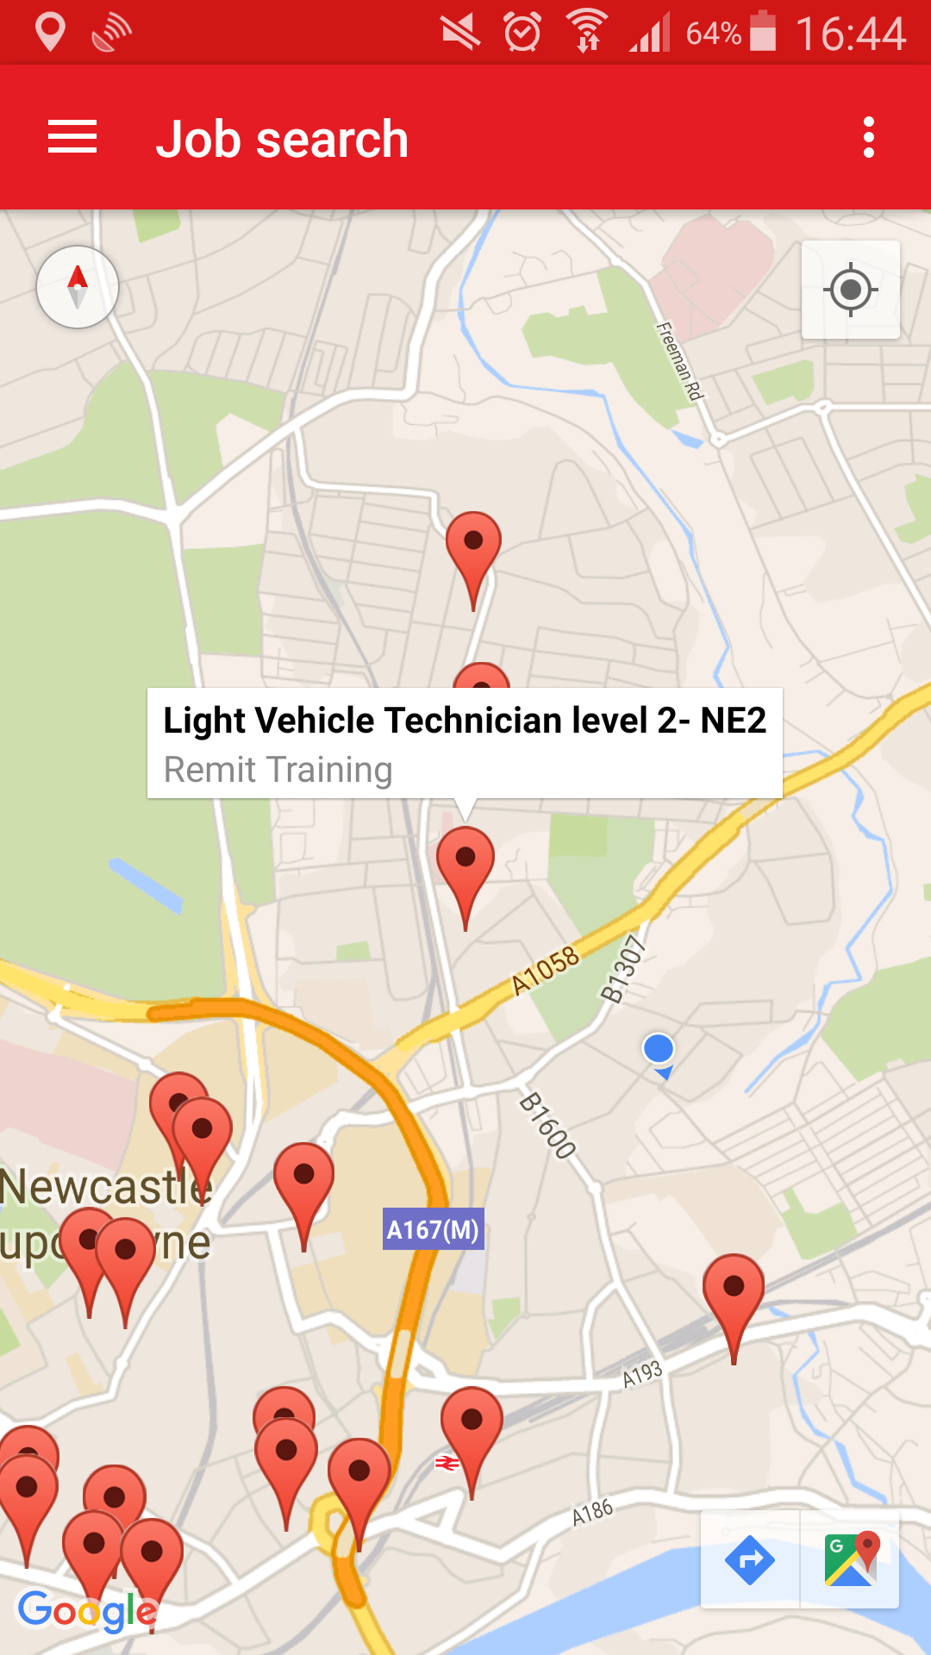
The proposed solution

Slide 6
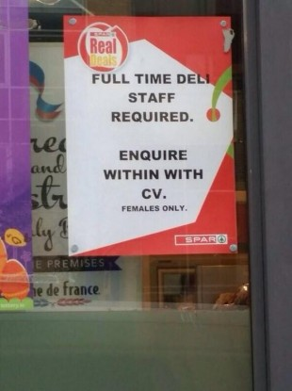
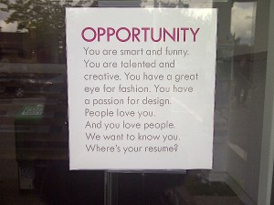

Crowdsourcing is (partly) the answer
http://media3.washingtonpost.com/wp-srv/photo/gallery/090813/GAL-09Aug13-2468/media/PHO-09Aug13-174151.jpg
http://www.rickiejosen.co.uk/wp-content/uploads/2012/07/Hire-ad-Kits-300x225.jpg
http://media3.washingtonpost.com/wp-srv/photo/gallery/090813/GAL-09Aug13-2468/media/PHO-09Aug13-174151.jpg

Slide 7
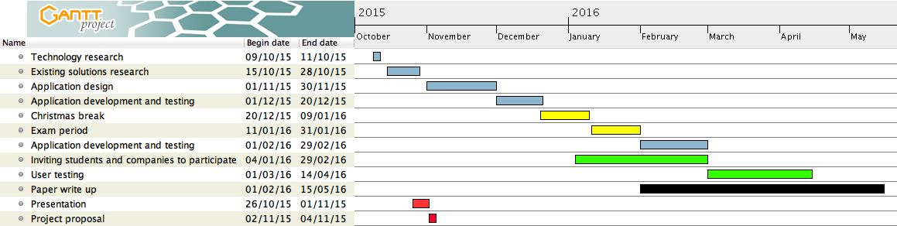
Timeline

Slide 8
Conclusions
An Android application to help the local job market
Heavily sensor-based
Element of crowdsourcing
Prototype of augmented reality

Slide 9
Questions?

